Slide 1

Food for Thought: Connections between Nutrition and Brain Health
Lisa Tussing-Humphreys, PhD, MS, RD
Assistant Professor, Department of Medicine
University of Illinois at Chicago
ltussing@uic.edu

Slide 2
Today’s Objectives
Learning to wade through ALL the nutrition and diet headlines
Connecting diet to brain health
  Define dementia and depression
  Risk factors for dementia and depression
  How is diet linked to brain health?
  Western diet and brain health
  Mediterranean diet and brain health

Slide 3
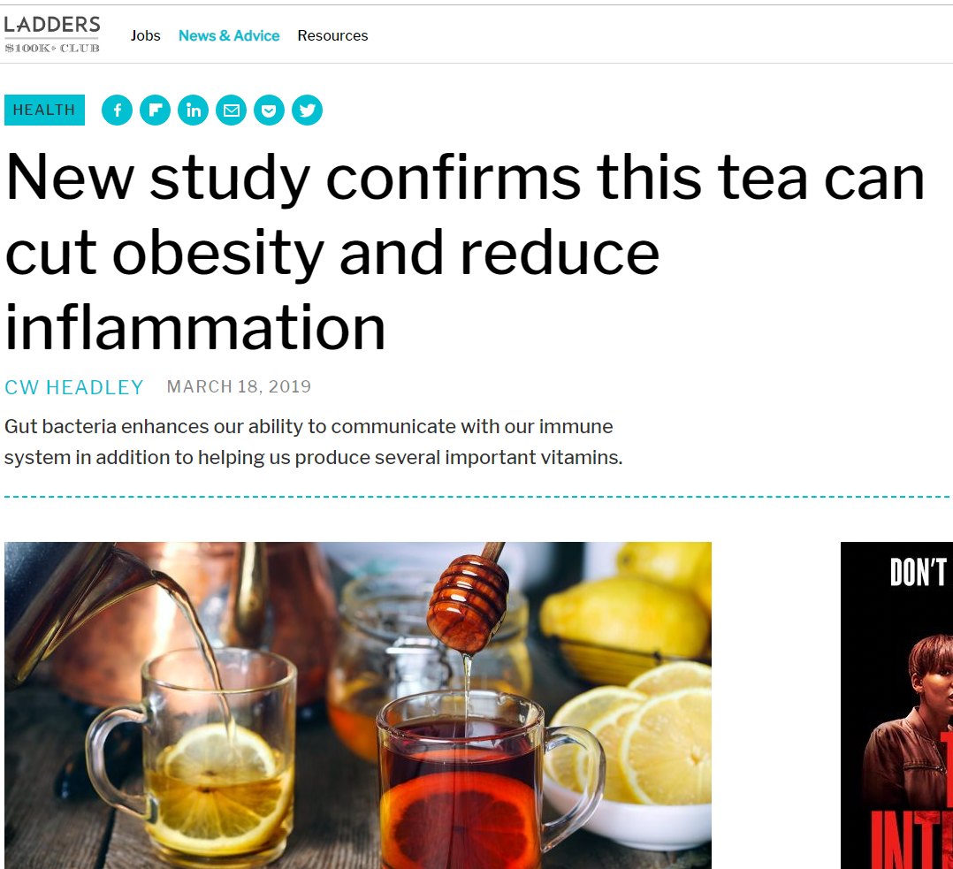
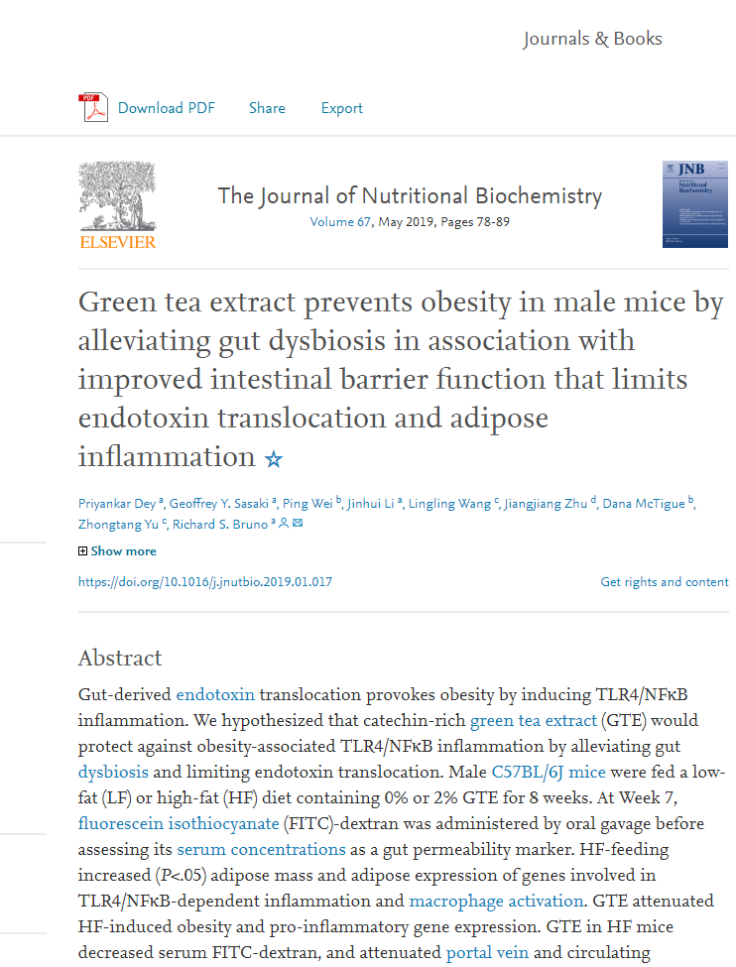
Nutrition Research:
Headline vs. Study

Slide 4
Be skeptical!
Is the story reporting the results of a single study?
How large is the study?
Was the study done on animals or humans?
Did the study look at real disease endpoints, such as heart disease or osteoporosis?
How was diet assessed?
What type of study is it?
https://www.hsph.harvard.edu/nutritionsource/media/

Slide 5
Don’t get discouraged!
Research is an ongoing process, with a steady stream of new studies published every month. Because dietary recommendations are made based on the best science available at that time, guidelines may change as new research becomes available.
Contradictions between published research papers may occur. They are an inevitable and healthy part of the scientific process.
Not all scientific studies are created equal. Some study types are more reliable than others.
Newer studies are not necessarily more reliable than older studies.
https://www.hsph.harvard.edu/nutritionsource/media/

Slide 6
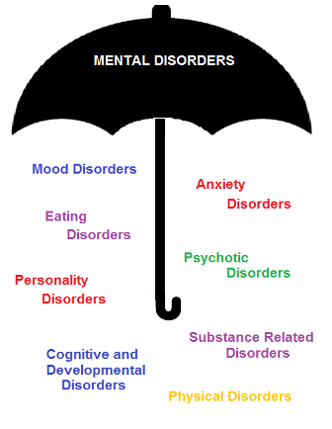
Mental Disorders: an Umbrella Term

Slide 7
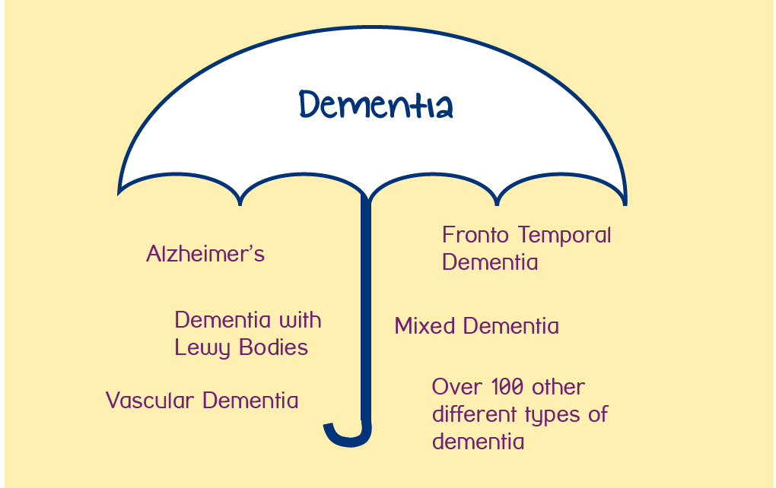
Dementia: an Umbrella Term
~ 6 million US adults are living with dementia
Alzheimer’s Association, 2018; Plassman et al., 2007; National Institute on Aging, 2017; WHO, 2017

Slide 8
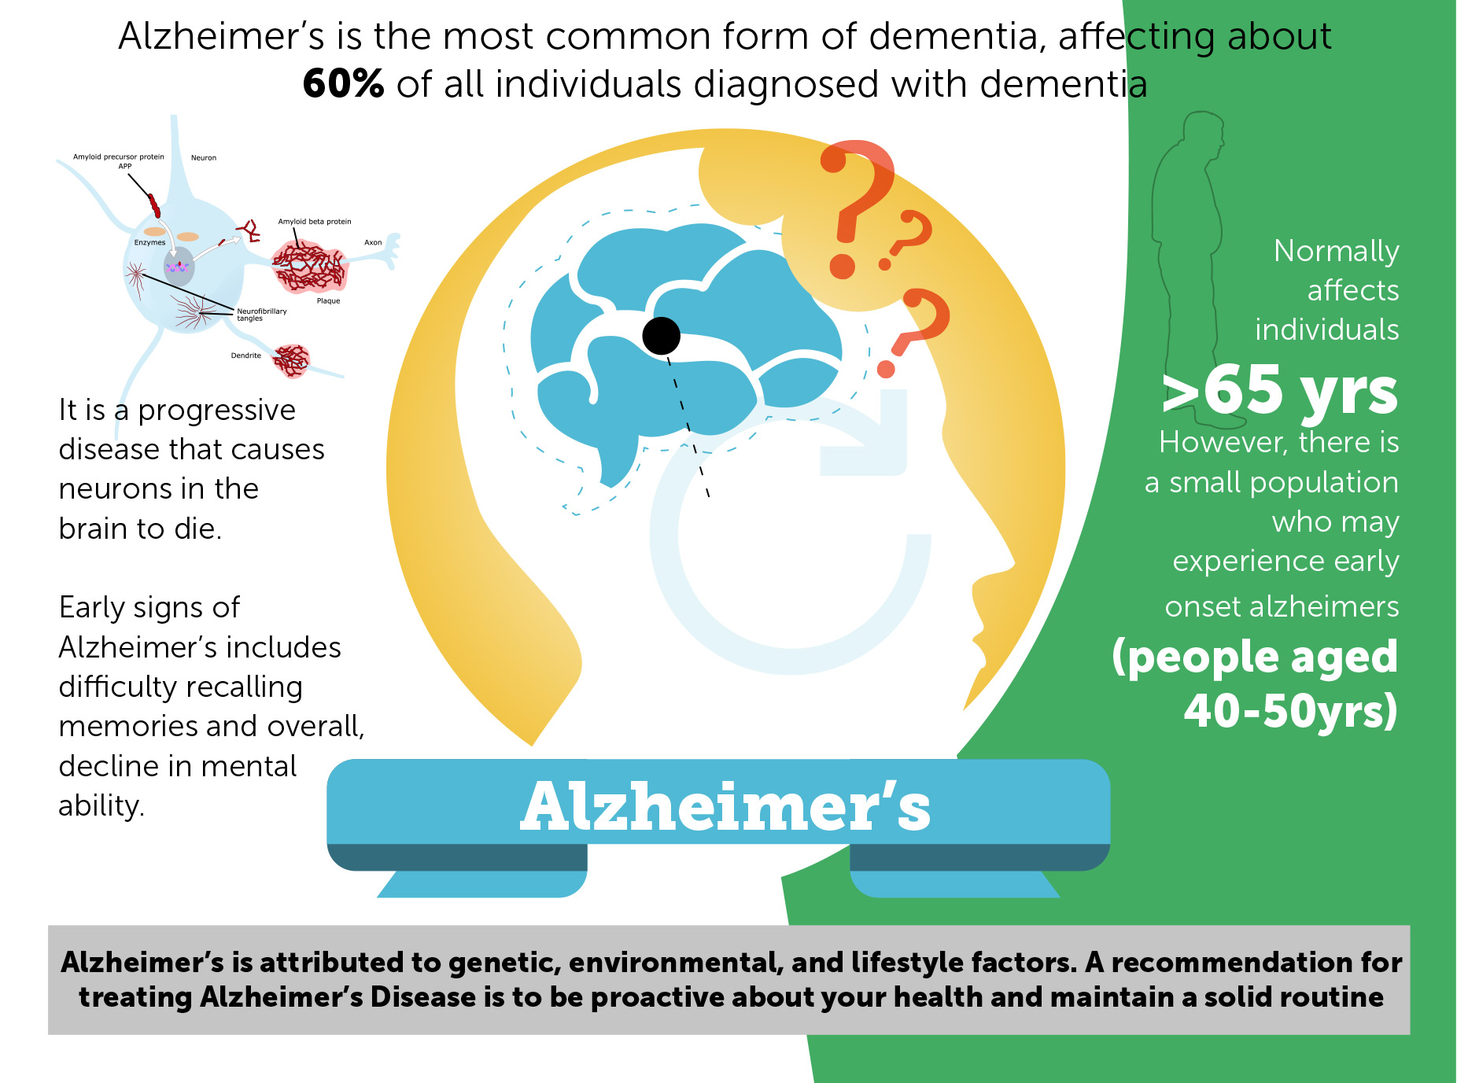
Alzheimer’s Dementia

Slide 9
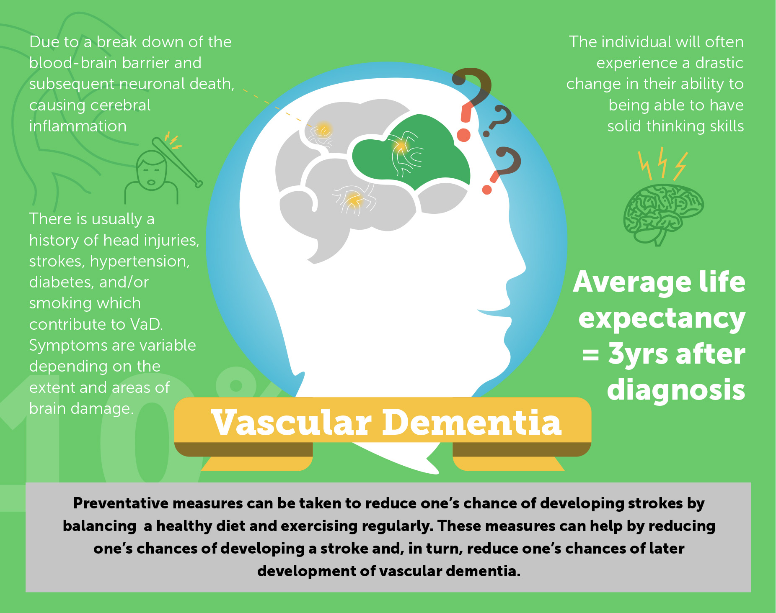
Vascular Dementia

Slide 10
Risk Factors and Protective Factors for Alzheimer’s and Vascular Dementia
Non-modifiable
Genetics
(e.g., APOE4)
Age
Biological Sex ♀
Modifiable
Diet
Physical activity
Obesity
Hypertension
Cholesterol
Type 2 diabetes
Cigarette use
CVD
Depression
Alcohol use
Social engagement?
Lifelong learning?
Years of education
Sleep?
Altmann et al., 2014; Carr, 2003; Farrer et al., 1997; Kypreos et al., 2009
Notes:
The greatest genetic risk factor for AD is APOE4, increasing risk 5- to 15-fold. There is longstanding evidence that compared to males, female APOE4 carriers have a greater lifetime risk for developing AD and an increased rate of cognitive decline. Obesity, poor diet, and commonly comorbid dyslipidemia exacerbate these associations. Postmenopausal decrease in estrogen increases the risk for weight gain and redistribution of adipose tissue to be more visceral, particularly in the presence of an unhealthy diet (e.g., high in saturated fats). Because female APOE4 carriers are at the greatest risk for cognitive decline, more so in presence of comorbid obesity and dyslipidemia, this population was specifically targeted for intervention.

Slide 11
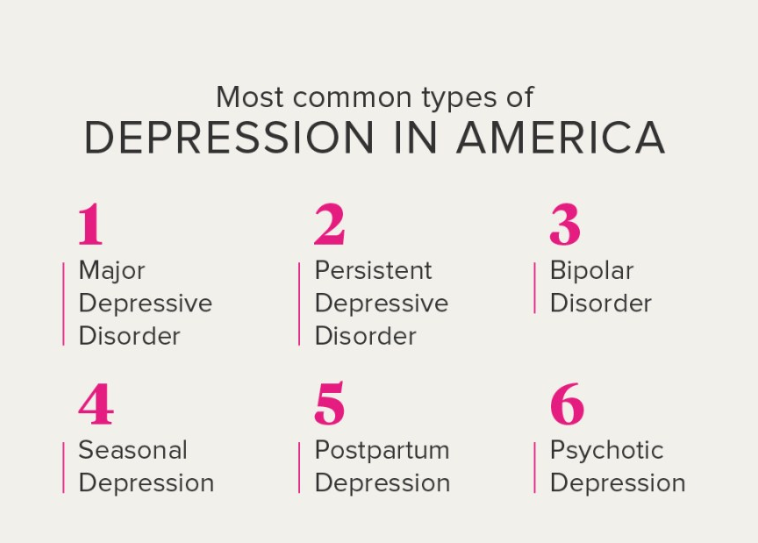
What’s Depression?
Depression symptoms :
Feeling sad or having a depressed mood
Loss of interest or pleasure in activities once enjoyed
Changes in appetite — weight loss or gain unrelated to dieting
Trouble sleeping or sleeping too much
Loss of energy or increased fatigue
Increase in purposeless physical activity (e.g., hand-wringing or pacing) or slowed movements and speech (actions observable by others)
Feeling worthless or guilty
Difficulty thinking, concentrating or making decisions
Thoughts of death or suicide
Symptoms must last at least two weeks for a diagnosis of depression.

Slide 12
Risk Factors and Protective Factors for Major Depression
Risk Factors
Protective Factors
Socio-economic status
Childhood trauma
Genetics
Biological sex
Substance abuse
Age
Major life events
Race/ethnicity
Physical health
Obesity?
Western diet?
Social support
Coping skills
Healthy diet?
Physical activity?
Spirituality?

Slide 13
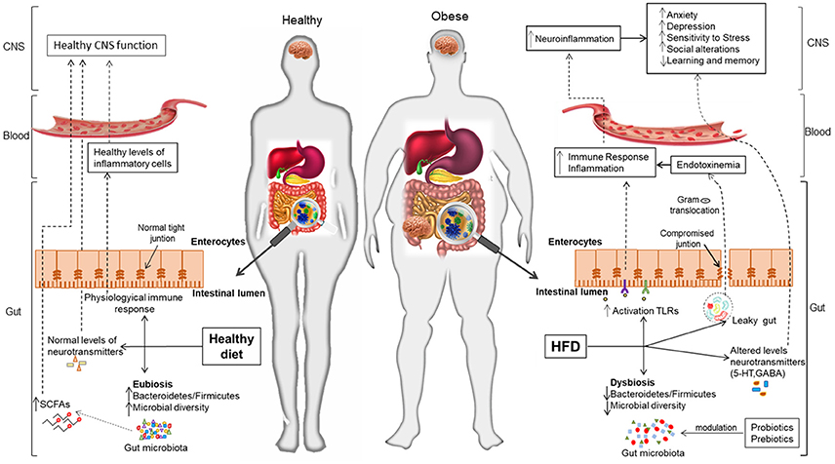
Mechanisms Linking Diet to Brain Health
Notes:
The gut microbiome may the key mechanism linking diet to cognitive health. This figure depicts the mediating effects the gut microbiome may have on the relationship between body weight and cognition and diet and cognition.
Looking first on the right, obesity and a Western-type High fat diet is associated with a state of gut dysbiosis characterized by decreased microbial diversity, a leaky gut, abnormal activation of the gut immune system, translocation of lipopolysaccharide into the circulatory system triggering endotoxemia and systemic inflammation that leads to neurodegenerative diseases including dementia.
Turning your attention to the lean individual. Imagine this is a person who lost weight or switched to a high quality diet like a Med Diet we see a diverse microbial community characterized by optimal metabolite production including SCFAs that promote gut intestinal epithelial integrity, decreased LPS translocation, and immune system homeostasis that contributes to healthy gut-brain communication and proper CNS function.
https://www.frontiersin.org/files/Articles/329519/fnins-12-00155-HTML/image_m/fnins-12-00155-g001.jpg

Slide 14

What’s a “Western” Diet?
High in:
Processed foods
Fast foods
Sugar/refined carbohydrates
Animal protein and fat
Low in:
Fruits and vegetables
Whole grains/fiber
Plant-based protein and fat

Slide 15
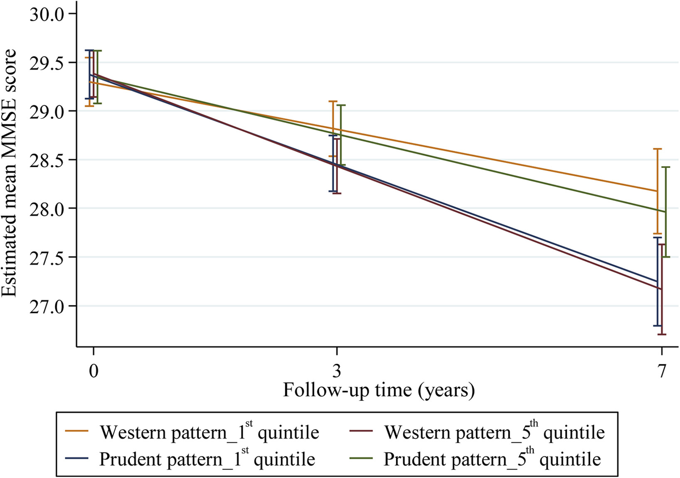
Western Diet vs. Prudent (Healthy) Diet Pattern and Association with Cognitive Decline in Adults
Shakersain et al. Alzheimer’s and Dementia, 2016
Notes:
2200 adults

Slide 16
Western Diet and Cognitive Decline in Adults
Gardener et al. Molecular Psychiatry, 2015
Notes:
400 men and women followed for 36 months.
Visuospatial ability refers to a person’s capacity to identify visual and spatial relationships among objects.

Slide 17
Western Diet Pattern and Depression in Adults

Slide 18
“Healthy” Diet Pattern and Depression in Adults

Slide 19
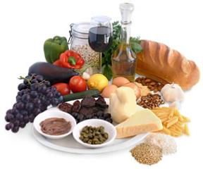
Mediterranean Diet (Med Diet)
A dietary pattern based on foods that were commonly consumed within several Mediterranean regions prior to the 1970’s (Ferro-Luzzi & Branca, 1995)
    Largely plant-based and high in fruits, vegetables, whole grain breads, rice and pasta, beans, nuts, and seeds
    Olive oil as the primary fat source
    Wine consumed in low to moderate amounts with meals
    Kris-Etherton P. et al. Circulation, 2001

Slide 20
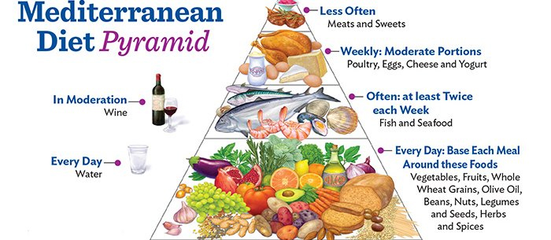
The Mediterranean Diet Pyramid

Slide 21
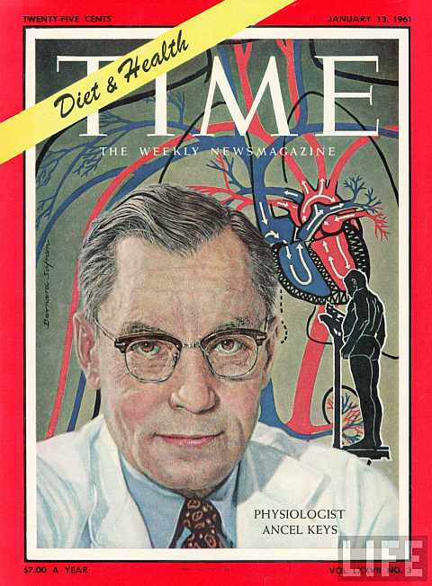
Mediterranean Diet- Early Evidence of Health Benefits
Seven countries study (1947)
  Study of healthy middle-aged men (U.S., N/S Europe, and Japan).
Aim was to examine the relationship between diet, lifestyle factors, and cardiovascular disease/stroke.
Disease rates and dietary patterns differed across countries.
  CHD and all-cause mortality was lower in cohorts where olive oil was the main source of fat.
Is the Med Diet responsible?
Keys et al., Am J Epi 1986.

Slide 22
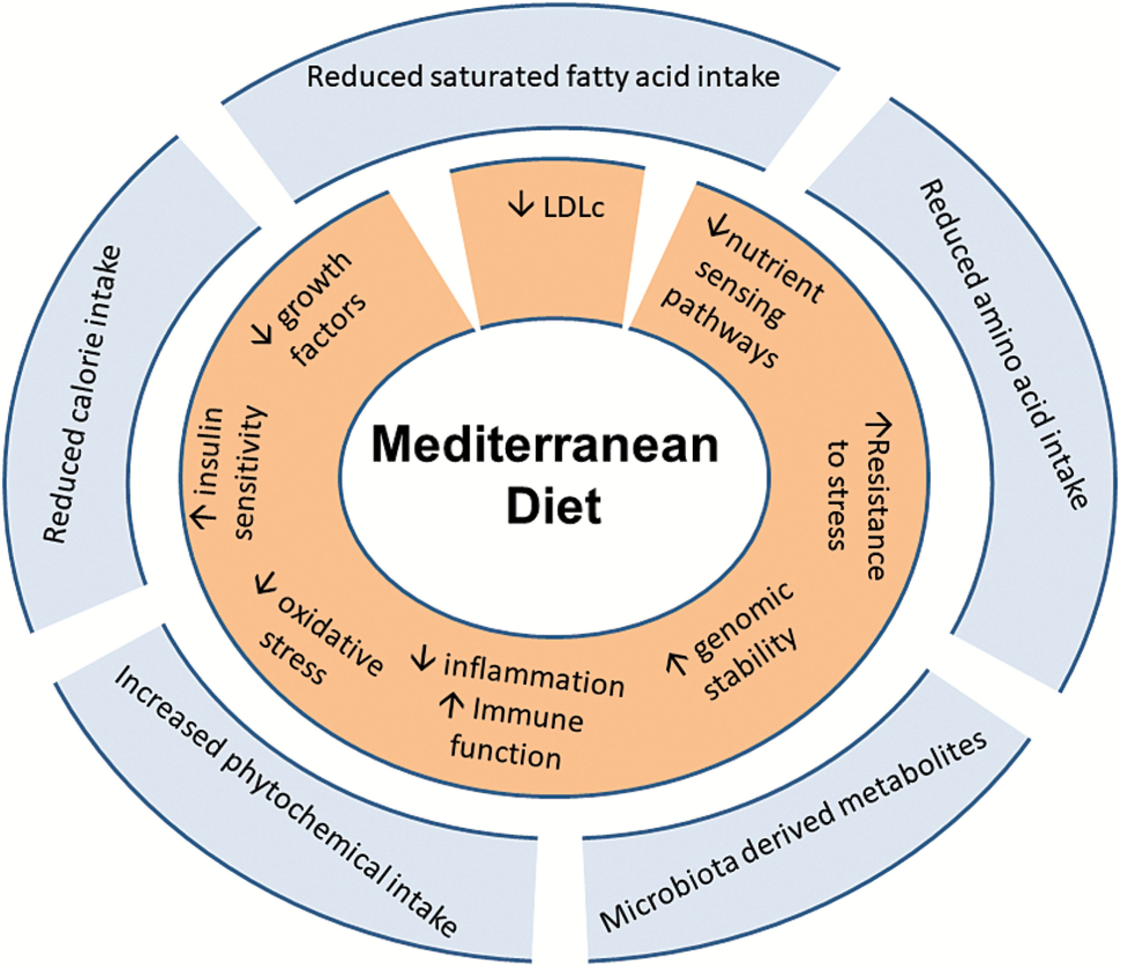
Protective Mechanisms of the Med Diet
Tosti et al. Journal of Gerontology, 2018
Notes:
Figure 1. The effectors of the Mediterranean Diet, including reduced saturated fatty acid intake, reduced amino acid and calorie intake, increased phytochemical intake, and microbiota derived metabolites.
22

Slide 23
Chicago Aging and Memory Project: Med Diet Adherence and Cognitive Decline
Tangney et al Neurology 2014
Notes:
800 older adults
Global cognitive score

Slide 24
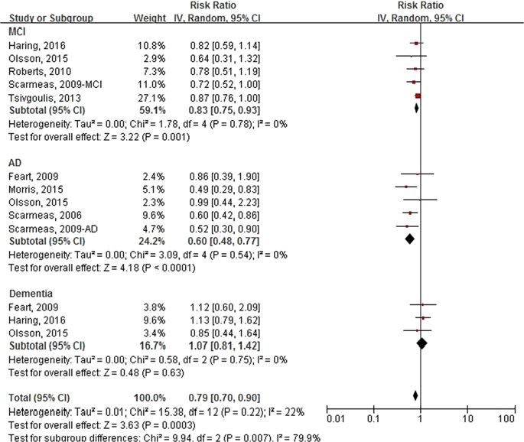
Med Diet and Cognition/Dementia: Observational Evidence
Wu and Sun, Sci Rep, 2017

Slide 25
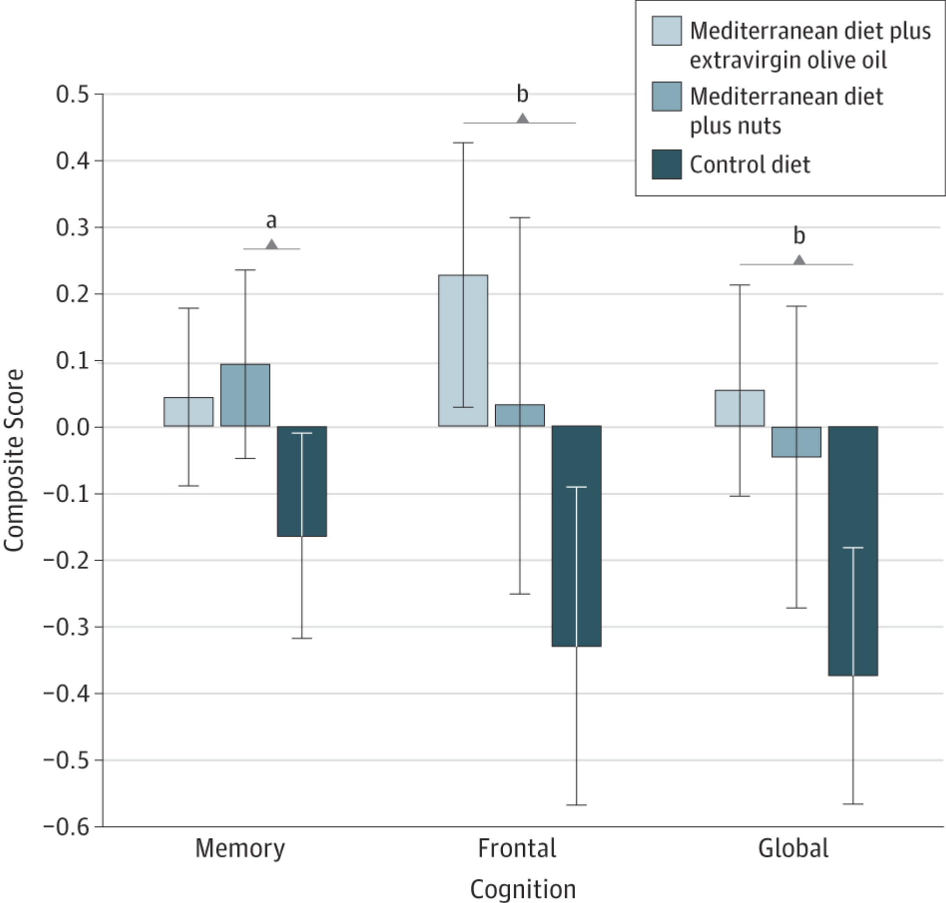
Mediterranean Diet and Age-Related Cognitive Decline: A Randomized Clinical Trial
Valls-Pedret et al JAMA Int Med, 2015
Notes:
447 adults
4 year follow up
1 liter of olive oil per week
1 ounce serving of nuts per day

Slide 26
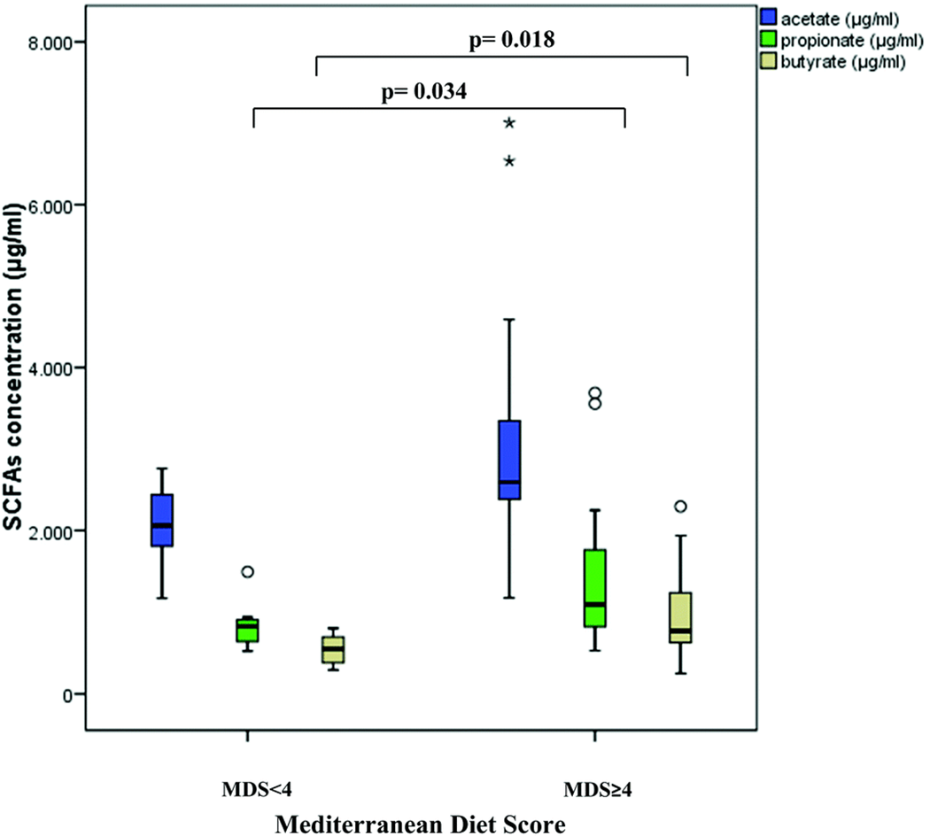
Med Diet and Gut Microbes: Links to Brain Health?
Gutierrez-Diaz et al. Roy Soc of Chem 2016

Slide 27


Building Research in Diet and Cognition Trial

Slide 28
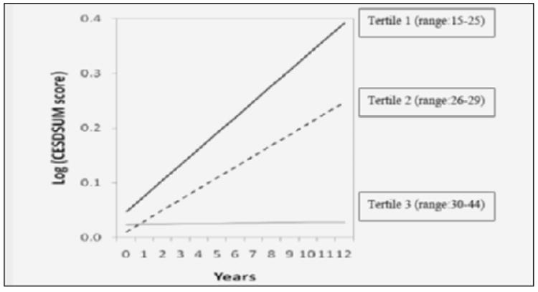
Chicago Health Aging and Memory Project: Med Diet and Depressive Symptoms
Skarupski et al J Nutr Health Aging, 2015
Notes:
5500 adults
No depression at baseline
Center for Epidemiologic Studies Depression scale
adherence to a Mediterranean diet is inversely related to developing depressive symptoms over time. persons in the top tertile of MedDietScore (range: 30-44) have a lower risk of depressive symptoms represented by the flatter slope of CESDSUM score than those in the middle tertile (range: 26-29) and lowest tertile (range: 15-25)

Slide 29
Med Diet and its association with depression among U.S. adults

Slide 30
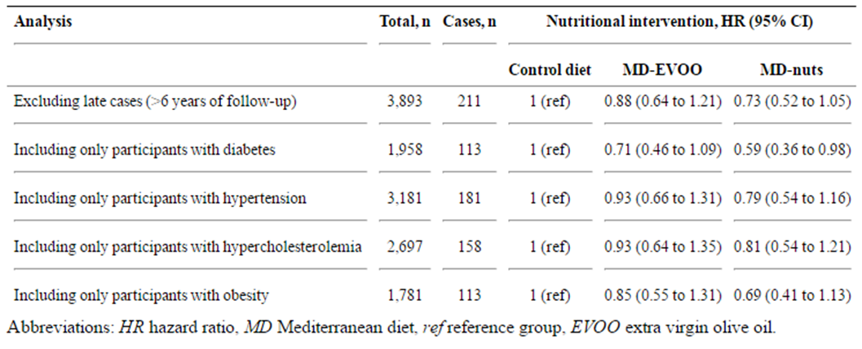
Med Diet and Depression in the PREDIMED Trial

Slide 31
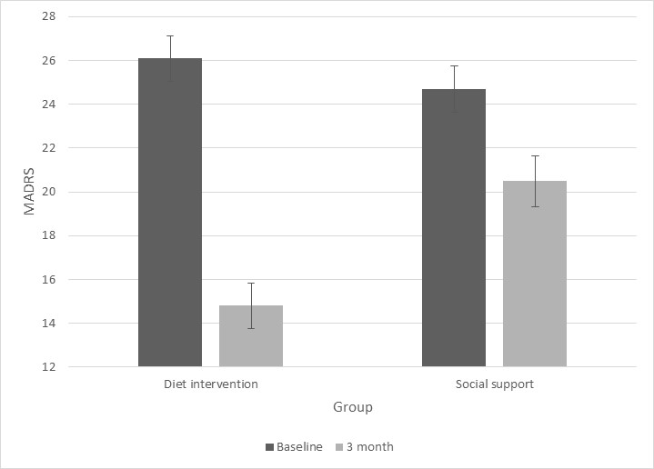
Med Diet for Treatment of Depression in Adults: SMILES
Jacka et al BMC Medicine 2017

Slide 32
Ongoing Studies

Slide 33
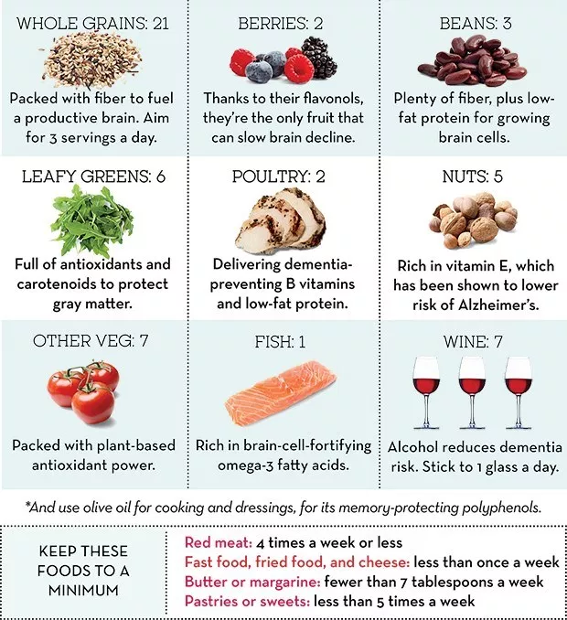
Other “Healthy Aging” Dietary Patterns
MIND Diet
Developed by Dr. Martha Clare Morris

Slide 34
Summary
Diet and brain health are linked
Med Diet can reduce risk for cognitive decline and depression
Med Diet may help treat depressive symptoms
More experimental studies in diverse groups of people are needed to understand what healthy diet pattern works best and for whom to maintain brain health

Slide 35
Thank you!

Slide 36
BRIDGE Trial

